Slide 1
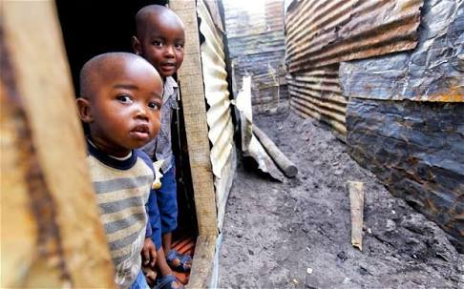
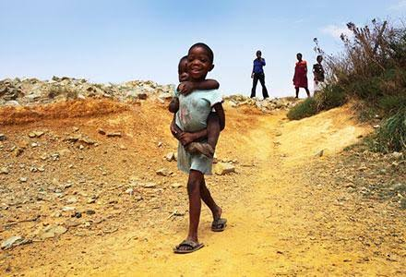
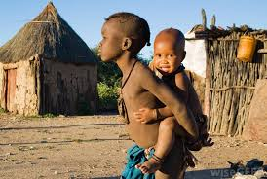
Using DEA to Evaluate African Pathway to Achieve Inclusive Green Growth: COMESA Case Study
Dr. Samar H. Albagoury
Faculty of African Post Graduate Studies, Cairo University

Slide 2
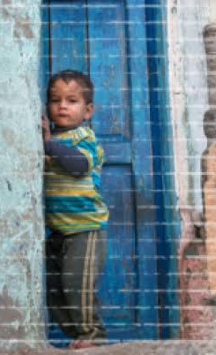
Africa is a clear example of the nexus between economic growth and poverty reduction, during the last decades many African countries manage to achieve relatively high growth rates hit two digits in some. But poverty still widely spread in those countries. There is 24 out of the 30 poorest countries in the world are African countries. And about 50% of African people still live under the poverty line.
This paper aims to test the effectiveness of economic growth achieved in COMESA countries in reducing poverty and achieving inclusive Growth, using Data Envelopment Analysis.

Slide 3
Contents:
Inclusive Growth: An Overview.
Inclusive Growth Indicators in COMESA countries.
Using DEA to evaluate COMESA achievement in inclusive growth.
Determinants of Inclusive Growth.

Slide 4
Inclusive Growth In COMESA Countries:
Country | GDP percapita | Poverty Rate | Gini Index | Unemployment | HDI | IHDI
Burundi | 275 | 64.6 | 38.6 | 1.5 | 0.417 | 0.278
Comoros | 1491 | 44.8 | 55.9 | 20.1 | 0.503 | 0.275
Congo, Dem | 565 | 63.6 | 42.1 | 3.6 | 0.457 | 0.319
Egypt | 2511 | 25.2 | 30.8 | 11.6 | 0.696 | 0.493
Eswatini | 3313 | 63 | 50.4 | 25.7 | 0.588 | 0.414
Ethiopia | 747 | 29.6 | 33.2 | 5.4 | 0.463 | 0.331
Kenya | 1726 | 45.9 | 48.5 | 11 | 0.59 | 0.434
Malawi | 375 | 50.7 | 46.1 | 6.7 | 0.477 | 0.332
Mauritius | 11195 | 11 | 35.8 | 7.4 | 0.79 | 0.683
Rwanda | 761 | 44.9 | 51.3 | 2.6 | 0.524 | 0.367
Seychelles | 16681 | 39.3 | 46.8 | 3.5 | 0.797 | 0.7
Sudan | 738 | 46.5 | 29.2 | 13.3 | 0.502 | 0.328
Uganda | 657 | 19.5 | 42.4 | 2.3 | 0.516 | 0.37
Zambia | 1356 | 60.5 | 55.6 | 7.4 | 0.588 | 0.388
Zimbabwe | 1273 | 72.3 | 43.2 | 5.3 | 0.535 | 0.408

Slide 5
Inclusive Growth In COMESA Countries:

Slide 6
Inclusive Growth In COMESA Countries:

Slide 7
There is a noticeable variation in the economic performance of the COMESA countries as could be noticed from the variation in real GDP growth rates. This rate varies from 1.4% in Burundi to 8.6% in Rwanda. But in general most countries of the region have achieved a relatively high growth rates, actually 10 out of 16 countries included in this analysis have a growth rate higher than 4%. And only 2 countries have a low growth rate below 2%.
The average real growth rate in this region is 4.8% which could be considered relatively high especially when it compares with African average growth rate 4%, or Emerging market and developing countries average growth rate 3.9% or even world growth rate 3%.

Slide 8
Inclusive Growth In COMESA Countries:

Slide 9
Inclusive Growth In COMESA Countries:

Slide 10
Inclusive Growth In COMESA Countries:
Poverty is still a severe problem in the majority of COMESA countries, where poverty rate exceeded 50% in 7 countries in this sample and even higher than 70% in two countries: Madagascar and Zimbabwe. On the other hand only three countries have a poverty rate below 25%: Egypt, Uganda and Mauritius.

Slide 11
Inclusive Growth In COMESA Countries:

Slide 12
Inclusive Growth In COMESA Countries:
In General this region has a moderate human development level as measured by human developed index. The lowest country is Burundi 0.417, while the highest is Seychelles 0.797. But the image changes when moving to Inequality Adjusted HDI, almost all COMESA countries loses a significance part of its HDI level reflecting the existence of inequality problem in all dimensions of HDI. Except Mauritius, all COMESA countries included in this analysis have IHDI below 0.450.

Slide 13
DEA Analysis:

Slide 14
DEA Analysis:
only two countries achieve a 100% efficiency score, Eswatini and Burundi. While other COMESA countries included in this analysis actually achieve a low efficiency score which is even below 50% (except Comoros 56%).
This result implies that even many COMESA countries achieving relatively good growth rates. This growth rate couldn’t considered as inclusive growth rate, since it doesn’t translated into adequate poverty reduction, more employment or even enhanced inequality levels.

Slide 15
Conclusion:
The paper concludes that COMESA Countries in general fail to transform its relatively high economic growth neither into poverty reduction nor into income distribution enhancement and so achieve Inclusive Growth. And that the main factors explain this failure is Economic Structure of those countries and weak internal economic performance.

